Slide 1
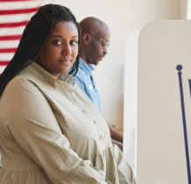
How to Run for Office in Harford County
Seminar presented by Gina Kazimir for the
NAACP Harford County Branch, Jan 22, 2022

Slide 2
Important Dates
Feb 22: Candidate Filings Due
Elections:
Early Voting will run from Thursday, June 16 through Thursday, June 23, 2022 from 7 am to 8 pm.
Primary Election Day is Tuesday, June 28, 2022 from 7 am to 8 pm
GENERAL ELECTION:
Early Voting will run from Thursday, October 27 through Thursday, November 3, 2022 from 7 am to 8 pm
Election Day is Tuesday, November 8, 2022 from 7 am to 8 pm.
PRIMARIES:
Candidate filing by appointment only. All paperwork must be filled out completely prior to your appointment or you will need to reschedule.
Contact any of our candidate filing coordinators to schedule your appointment or call 410-638-3565
Stephen Feryus – 410-809-6036 Sarah Mohan – 410-809-6026 Stephanie Taylor – 410-809-6003

Slide 3
Current list of candidates
The most current list of candidates can be found here:
https://elections.maryland.gov/elections/2022/primary_candidates/gen_cand_lists_2022_1_by_county_13.html
As of 1/21/22:
County Council President: GOP only, no opposition District B: GOP Primary, no opposition
District C: GOP only, no opposition District D: GOP only, no opposition
District E: GOP Primary, no opposition
Board of Education (non partisan): NO CANDIDATES in District B & C, no opposition in all other districts
States Attorney: GOP Primary, no opposition Sheriff: GOP only, no opposition
Clerk of the Court: GOP Primary, no opposition Register of Wills: GOP only, no opposition

Slide 4
How to Campaign
Make sure your employment allows you to run
Determine your Why
Pick your Platform
Consider training
Set up a website, email, phone & social media
Plan how to share your message
Talk to people
Be yourself
Don’t take it personally!

Slide 5
Where to File:
Harford County Board of Elections
133 Industry Lane, Forest Hill, MD 21050
410-638-3565

Slide 6
Where to find candidate information
Harford County Board of Elections:
https://harfordvotes.info/?page_id=36
State Board of Elections:
Info: https://elections.maryland.gov/candidacy/index.html
Forms: https://elections.maryland.gov/forms/petitions.html#candidacy

Slide 7
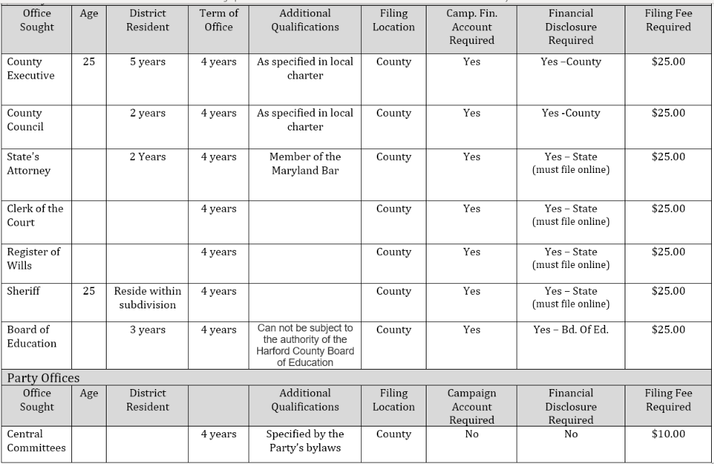
Harford County Candidacy Requirements: Note, filing fee payment is by check only

Slide 8
Funding Your Campaign
Two Options:
Create a Candidate Organization. This is how you raise funds, and to do so candidates need to set up a committee or friends group that will register with the Maryland State Board of Elections and file financial updates as required. To register online, go to https://campaignfinance.maryland.gov/Home/RegisterCommittees and register a Candidate Committee.
Limit your spending. Candidates who don’t plan to have campaign finance activity greater than $1,000 may file an Affidavit of Limited Contributions and Expenditures instead of a detailed campaign finance report. The Affidavit must be filed for every reporting period. Only when the Affidavit is marked final will the filing obligations end.
NOTE: Conducting campaign finance activity prior to the filing of the statement of organization is prohibited.

Slide 9
Maryland Political Parties
As of December 2021, there were six officially recognized political parties in Maryland:
Democratic Party of Maryland
Republican Party of Maryland
Libertarian Party of Maryland
Bread and Roses Party of Maryland
Green Party of Maryland
Working Class Party of Maryland
Democratic and Republican parties are considered principal parties; all others are non-principal.
More info: https://ballotpedia.org/Ballot_access_requirements_for_political_parties_in_Maryland

Slide 10
For more information
Website: http://www.harconaacp.org/
Phone: (443) 619-7908
Email: naacpharco@gmail.com
Follow us on Facebook @naacpharco

